Slide 1
PHP7.1 New Features & Performance
@Laruence

Slide 2
About Me
Author of Yaf, Yar, Yac, Yaconf, Taint, Lua, etc
Maintainer of APC, Zend Opcache, Msgpack
PHP core developer since 2011
Zend consultant since 2013
Core author of PHP7
Chief Architect at Lianjia

Slide 3
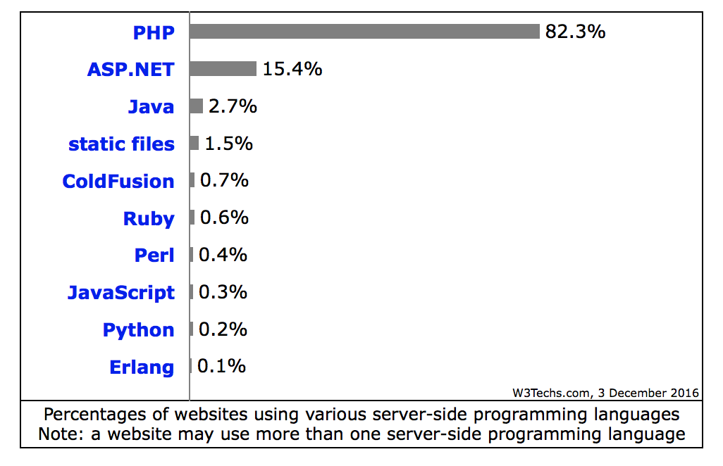
PHP
20 years history
Most popular Web service program language
Over 82% sites are use PHP as server side program language
Latest version is PHP-7.1

Slide 4
PHP71
Nullable types
Void return type
Iterable pseudo-type
Class constant visibility modifiers
Specify keys in list()
Square bracket syntax for list()
Catching multiple exception types
Missing arguments Excetpion
Warn about invalid strings in arithmetic
Generalize support of negative string offsets
….

Slide 5
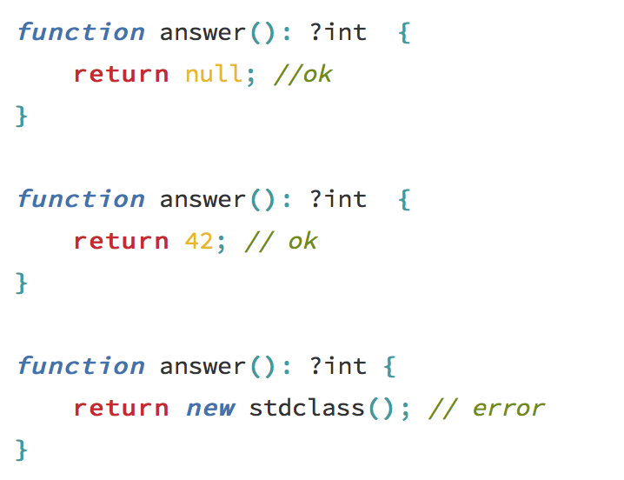
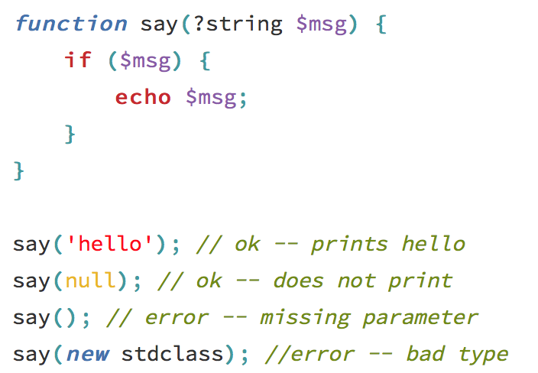
Nullable types
An enhancement for typehints
return type
parameters

Slide 6
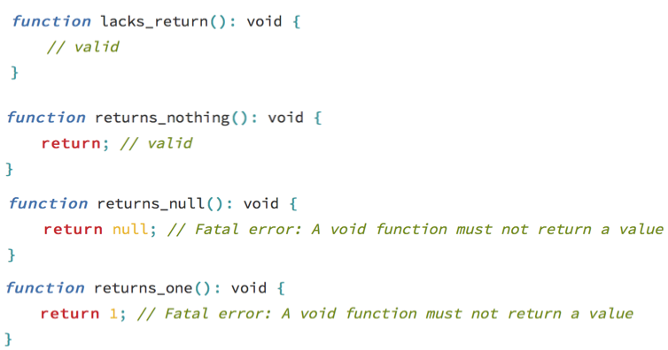
Void return types
An enhancement for return type hint

Slide 7
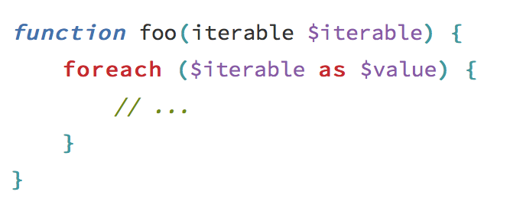
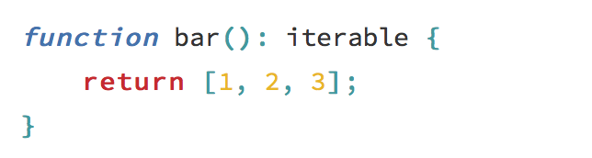
Iterable Pseudo type
Iterable accepts any array or object implementing Traversable
Iterable can also be used in return type

Slide 8

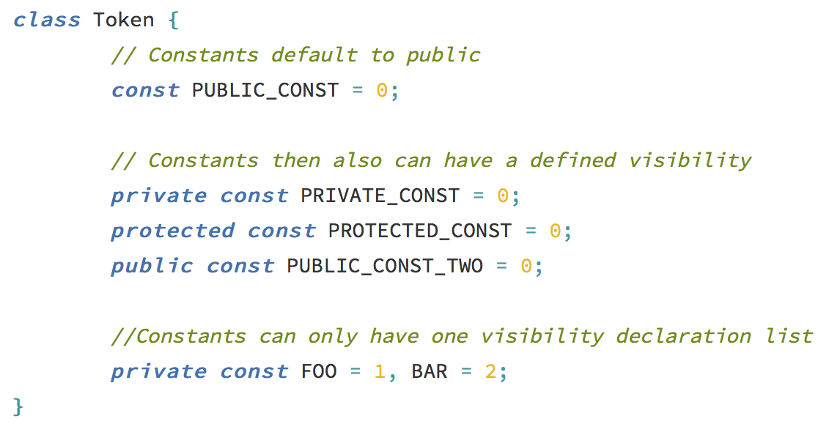
Class constant visibility modifiers
Support class constant visibility

Slide 9
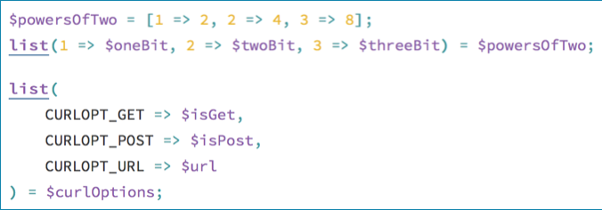
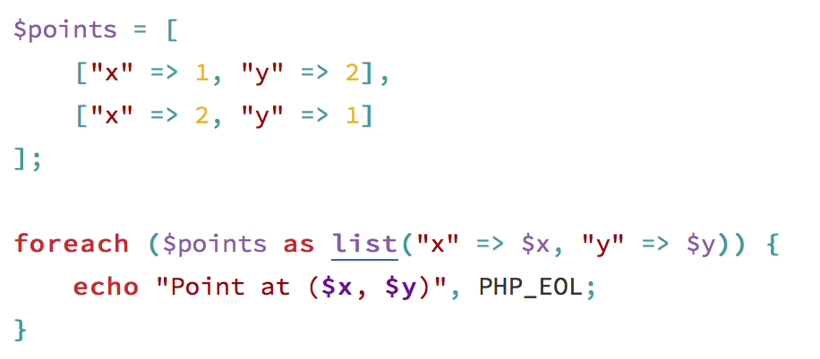
Specify keys in list()
An enhancement for list()
Also works in foreach
specify keys in list
specify keys in list with foreach

Slide 10
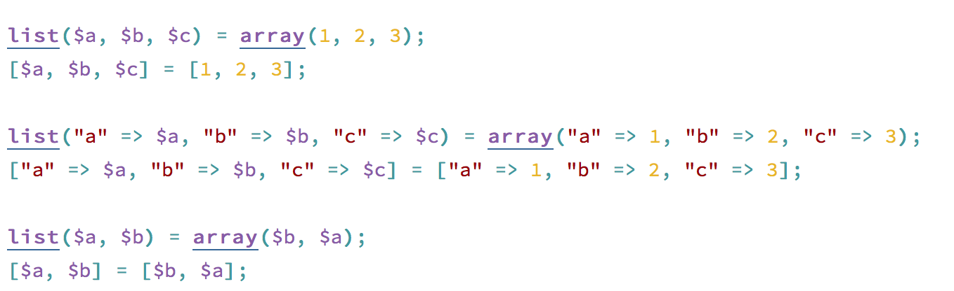
Square backtrace for list()
Continuation syntax for short array syntax introduced in 5.4
Also works in foreach too

Slide 11
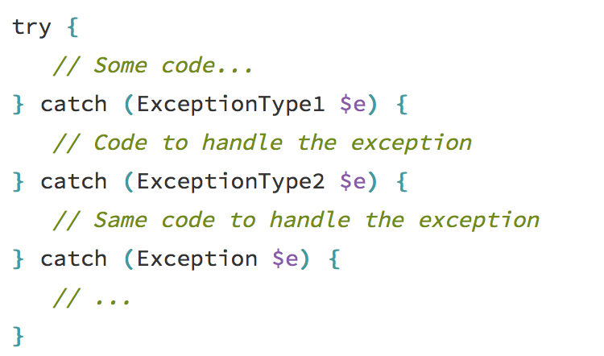
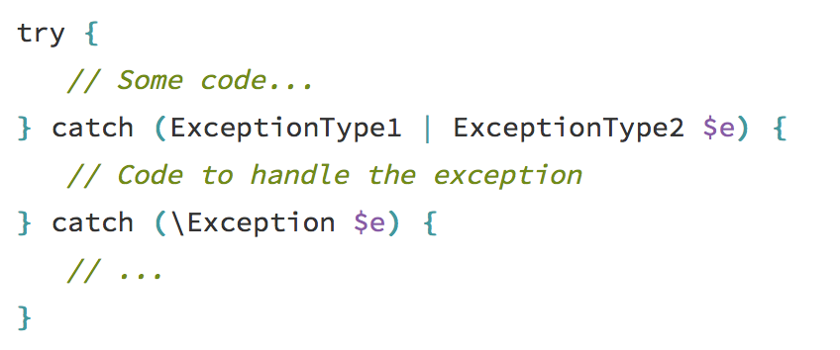
Catching multiply exception types
Allow catching multiply exception types in single catch
normal way
PHP71 way

Slide 12
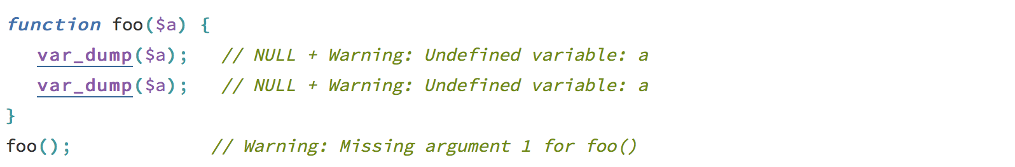
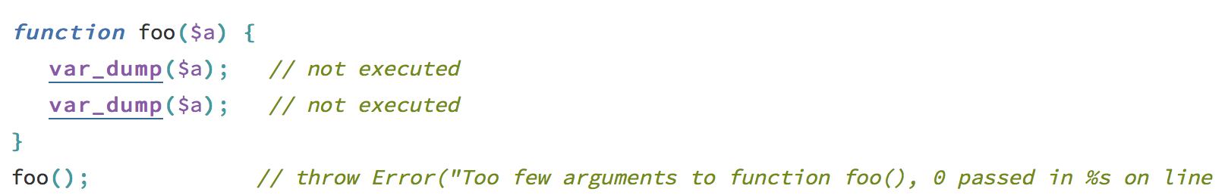
Missing Arguments Exception
Disable calling “user” functions with insufficient actual parameters
before 71
after 71

Slide 13
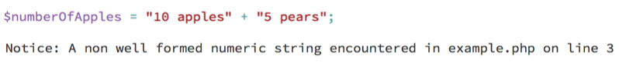
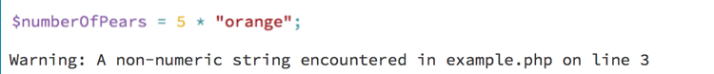
Warn about invalid strings in arithmetic
Produce E_NOTICE or E_WARNING when using invalid numeric strings with arithmetic operators

Slide 14
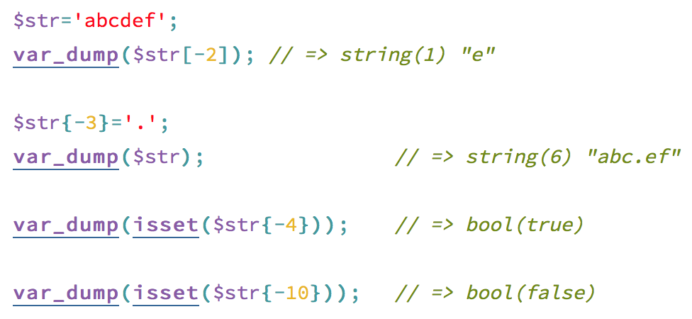
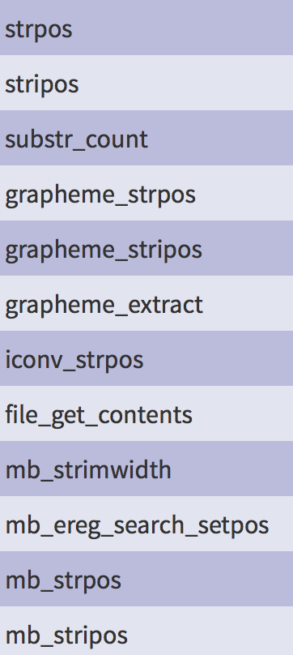
Generalize support of negative string offsets
Support of negative string offsets when it make sense

Slide 15
One More thing

Slide 16
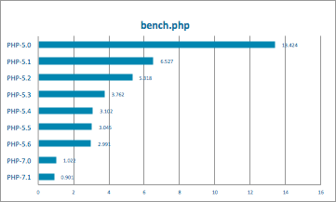
PHP71 Performance
Over 10% Perfromance improvement

Slide 17
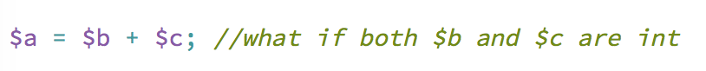
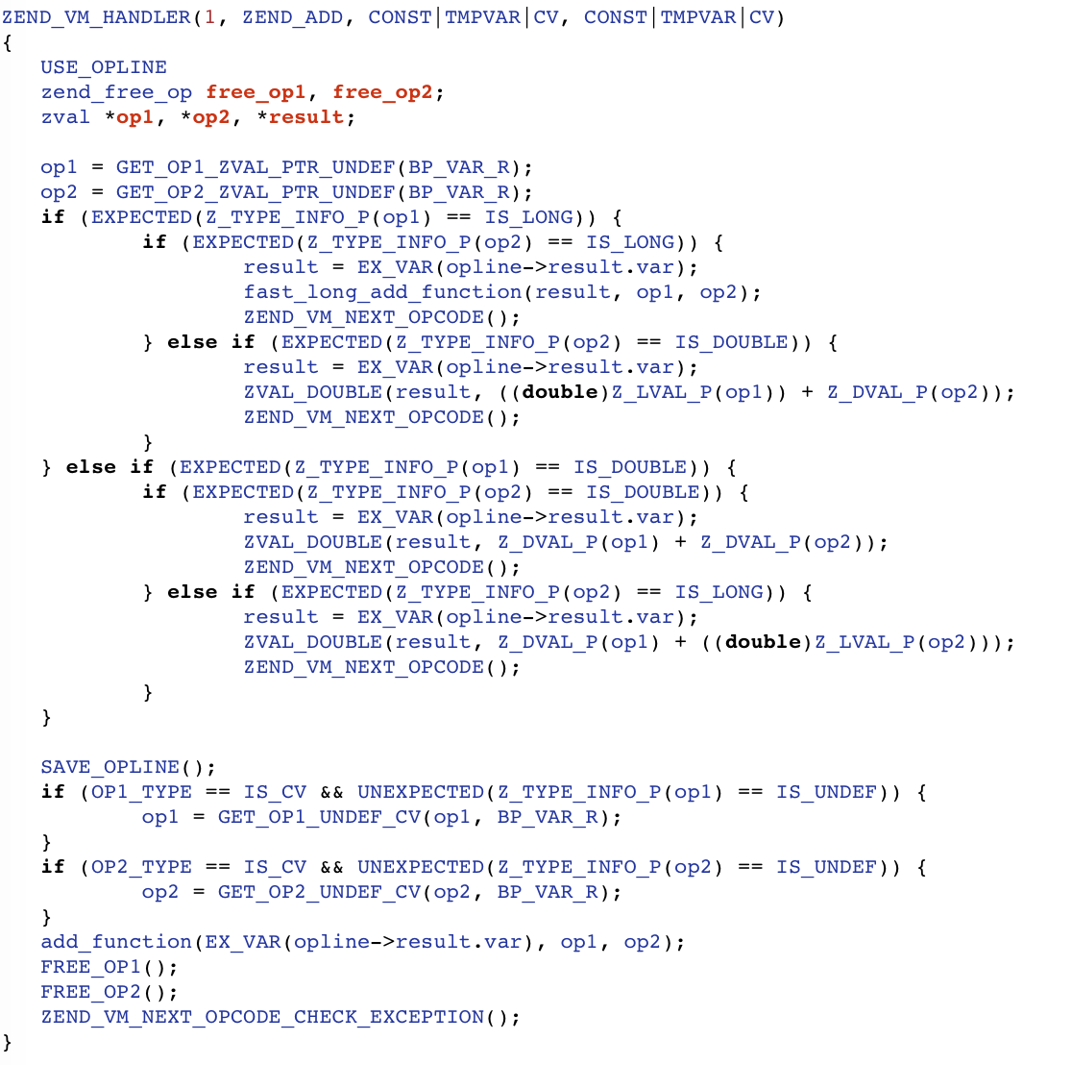
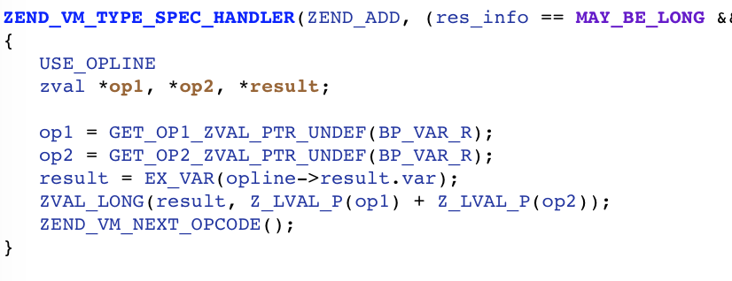
Type specific opcode handlers
ZEND_ADD_LONG_LONG
ZEND_ADD

Slide 18
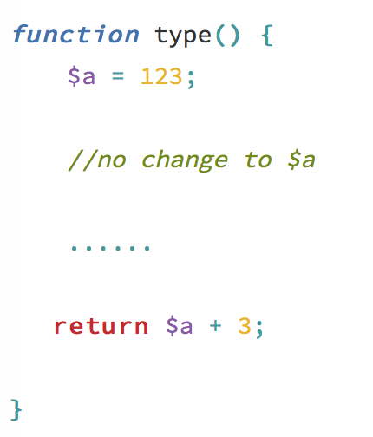
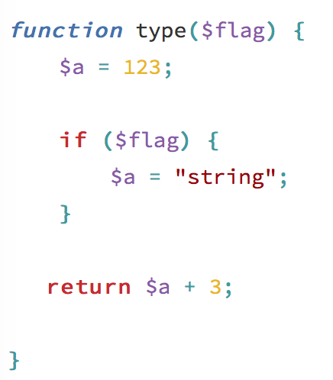
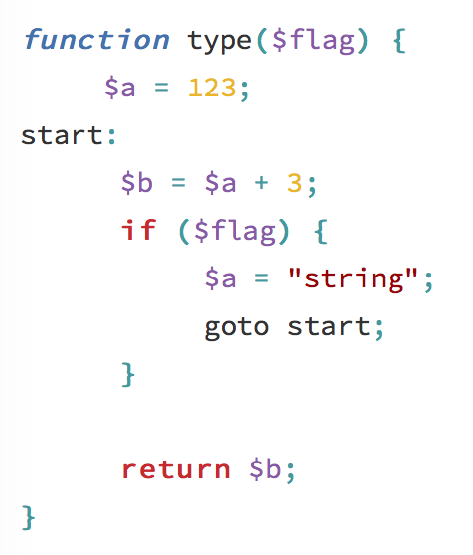
Type Inference system
Part work of our JIT in 2013
normal
branch
loop

Slide 19
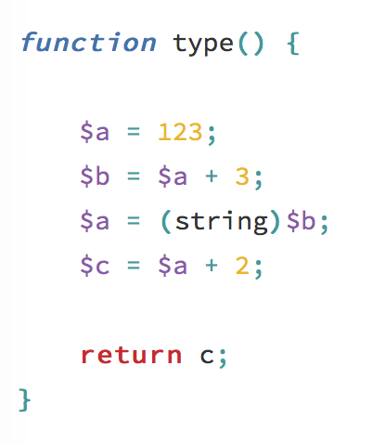
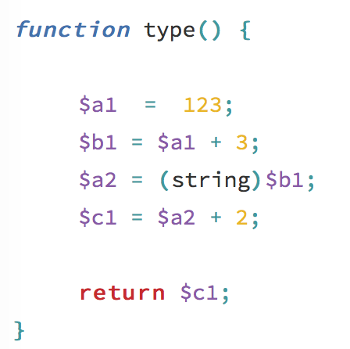
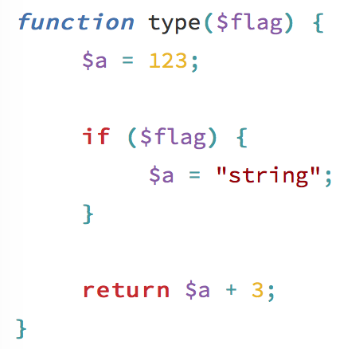
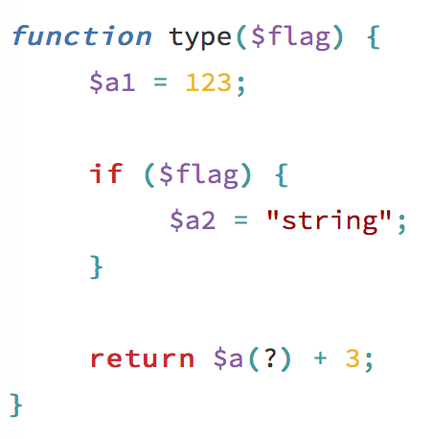
SSA
Static Single-Assignment form
Explicit use-def chain

Slide 20
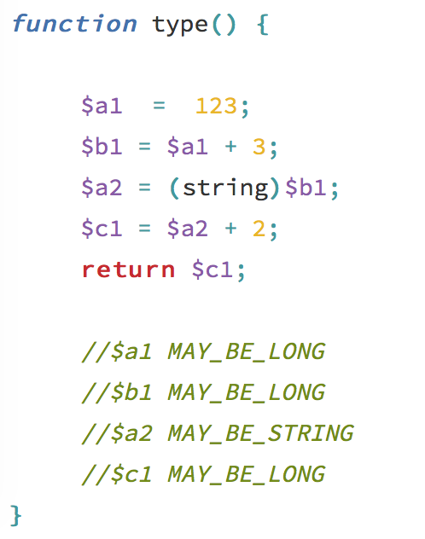
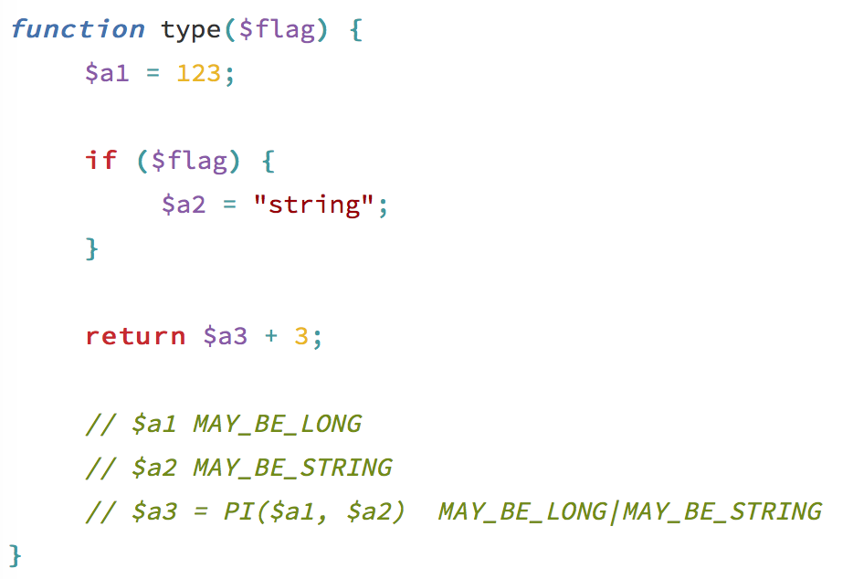
Type Inference
What’s ? ’s type at ? point
Computed in compiling time

Slide 21
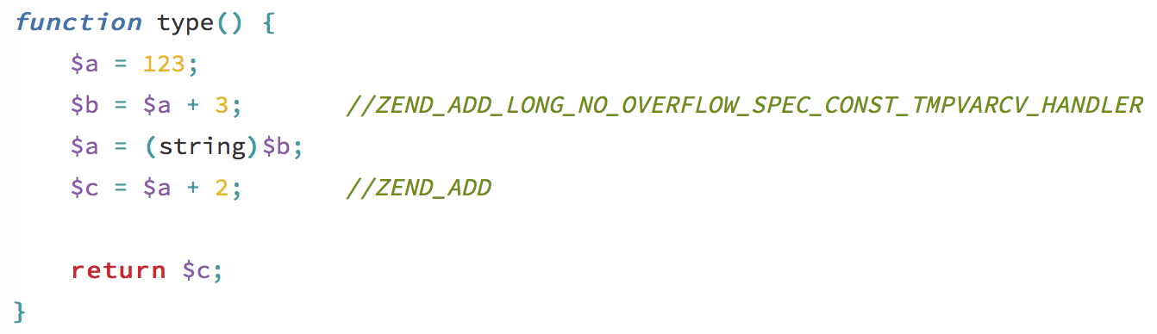
Type Specific opcode handler
Use type specific opcode handler if possible

Slide 22
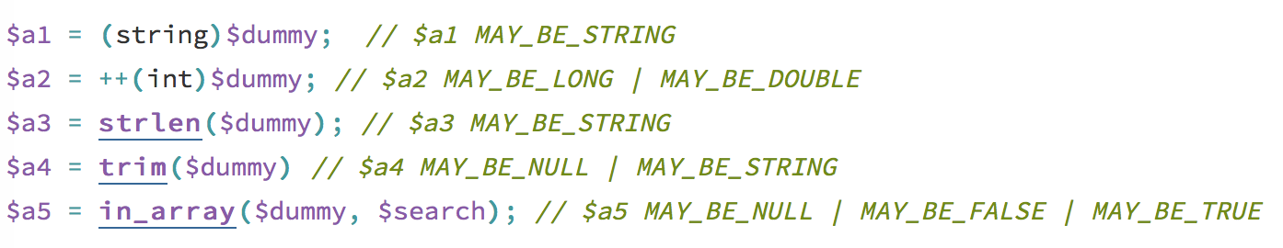
Type Inference system
A tedious work
And we can only get ~30% type-infos in WP

Slide 23
Type Specific opcode handlers
ZEND_ADD(SUB|MUL)
ZEND_PRE_INC(DEC)
ZEND_POST_INC(DEC)
ZEND_IS_(NOT_)EQUAL
ZEND_IS_SMALLER(_OR_EQUAL)
ZEND_QM_ASSIGN
ZEND_SEND_VAR(_EX)
ZEND_FETCH_DIM_R

Slide 24
And dozens of minor improvements
More packed array constructions
Constant propagation based on DFA
Return type checks eliding
dozens of minor improvements even I can not recall

Slide 25
Q&A

